Slide 1

CSCI 297: Generative AI: Creating with Computation
Introduction to Generative AI

Slide 2
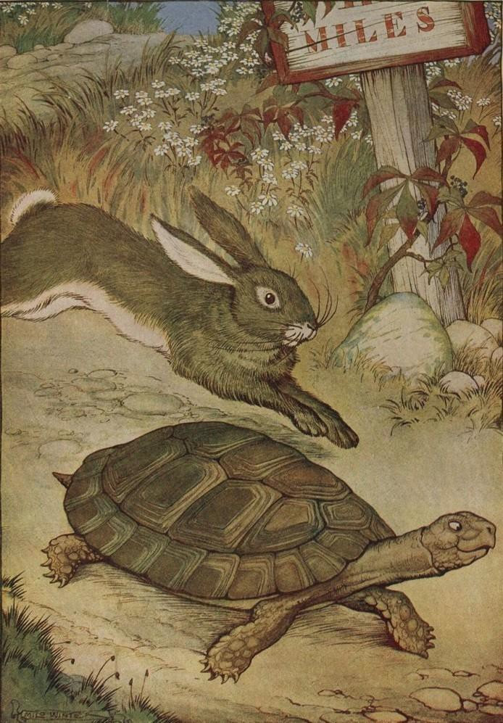


The race to release LLMs – AI has never changed so fast
Google shares fall by 8%
Geoffrey Hinton
leaves Google
OpenAI: ChatGPT
MS event:
New Bing
FLI Open
Letter
Sam Altman
Senate Hearing
Dec
Jan
Feb
Mar
Apr
May
June
Google: Bard
OpenAI: GPT4
1st vote on EU AI Act
Google event in Paris

Slide 3
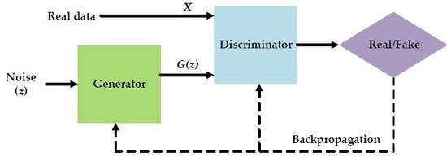


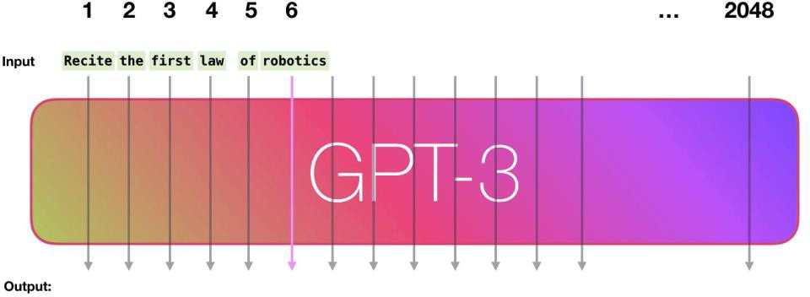
Where it all comes from: GANs, LLMs & Diffusers
This Person Does Not Exist
Generative Adversarial
Networks (2014)
The Generator creates deep fakes to train the Discriminator.
Diffusers (since 2020) – Example from DALLE2 (Open AI, 2022) "Teddy bears mixing sparkling chemicals as mad scientists in a steampunk style“ – create images from text and by de-noising.
Large language models perform sequence-to-sequence prediction and generate the next word in a sentence. (Transformer networks, since 2018)

Slide 4

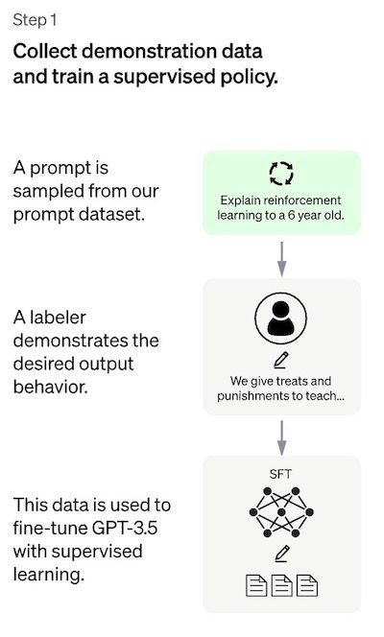
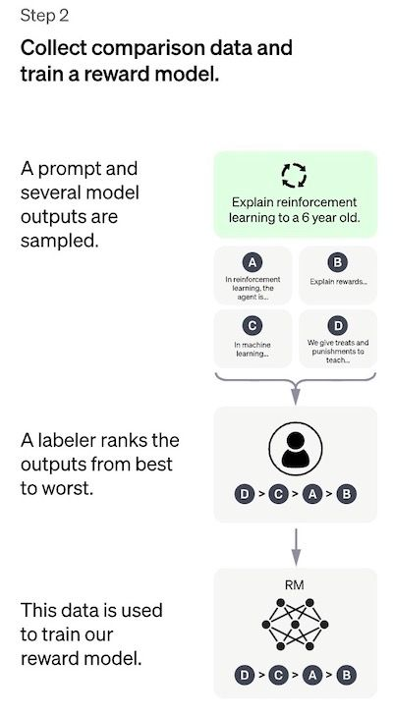
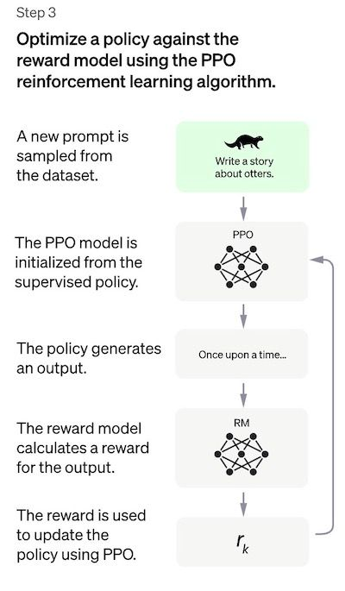
How ChatGPT from Open AI was trained

Slide 5
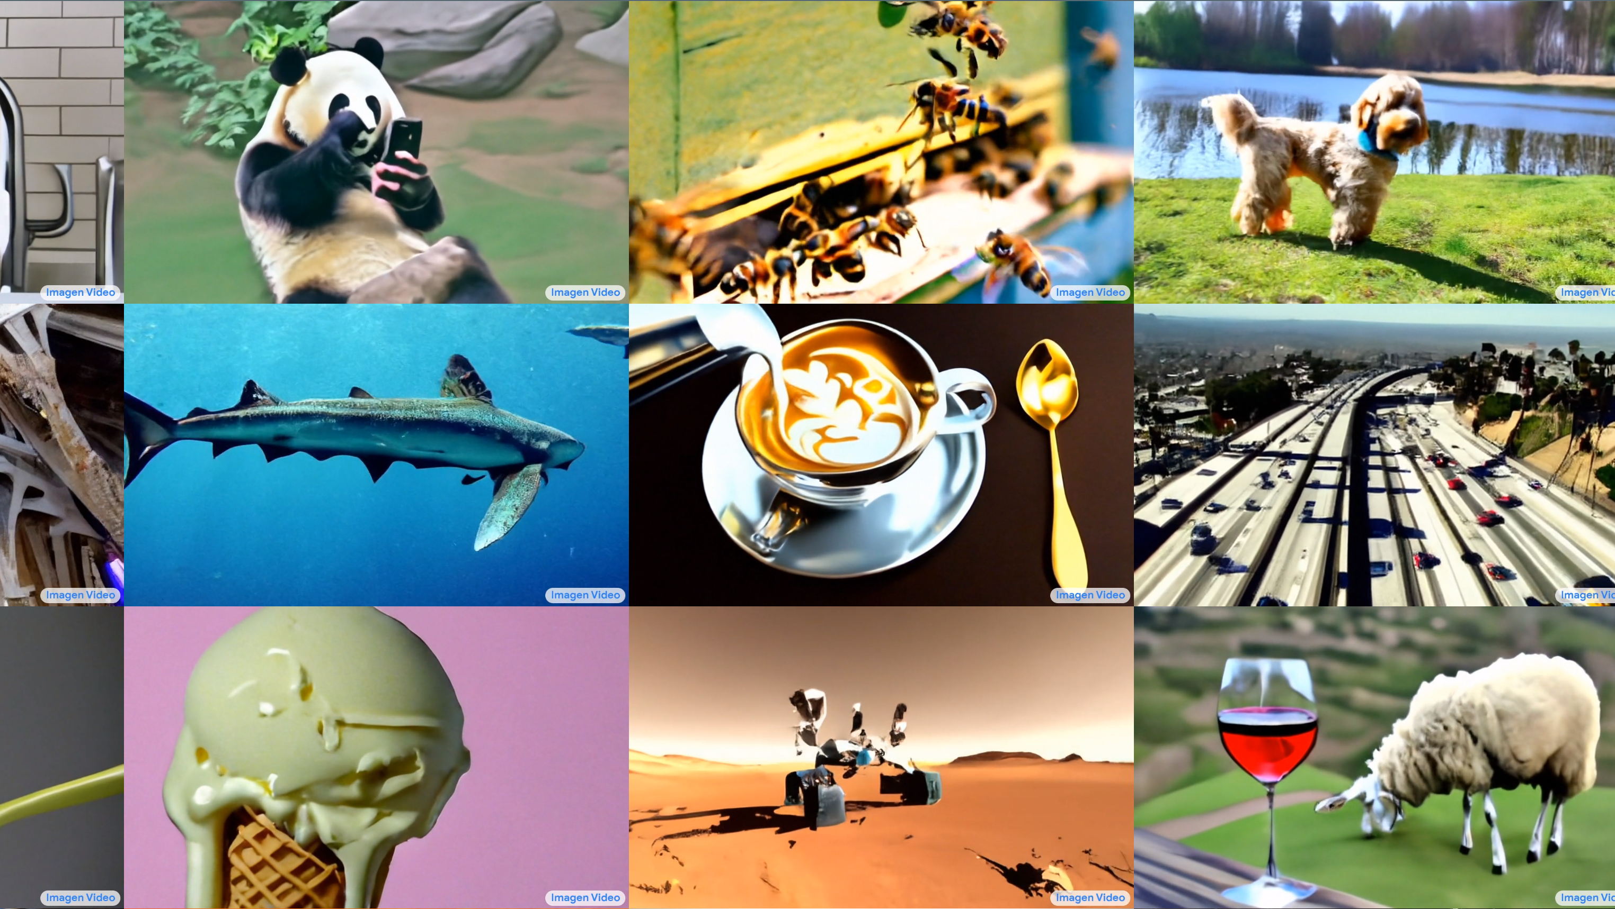
Images…Why Not Videos?

Slide 6
LLMs vs Thinking, Where are We?
The recent progress and popularity of Large Language Models(models trained auto-regressively to predict the next word given a phrase or masked language modelling) has divided the AI community in two —
Group A : We’re at the cusp of an AI revolution. AGI is within reach in next few years.
Group B : LLMs are nothing special but just stochastic parrots.

Slide 7
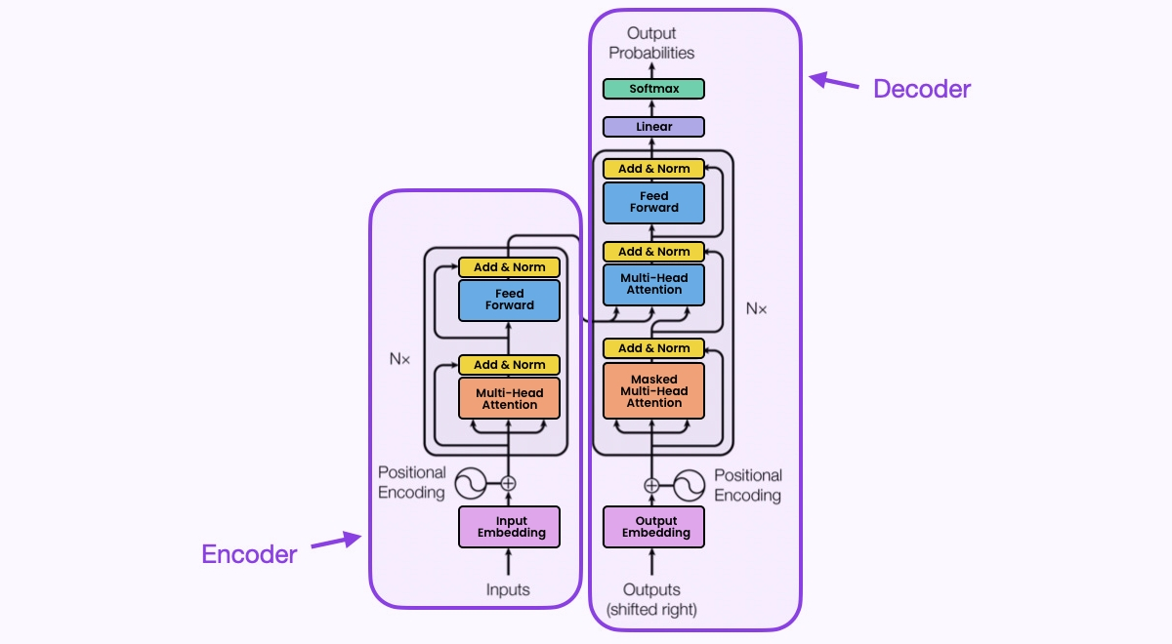
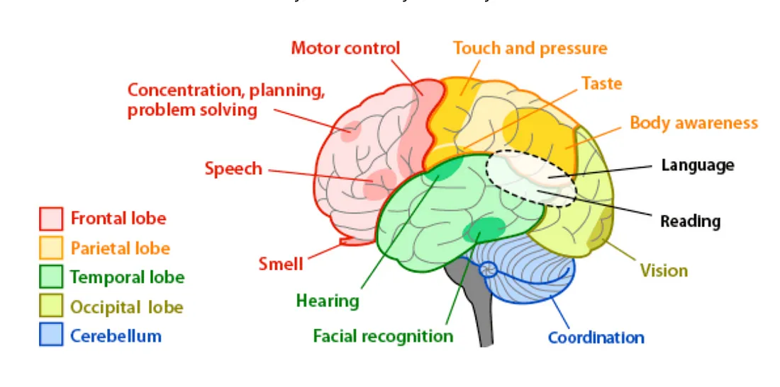
LLM vs Brain

Slide 8
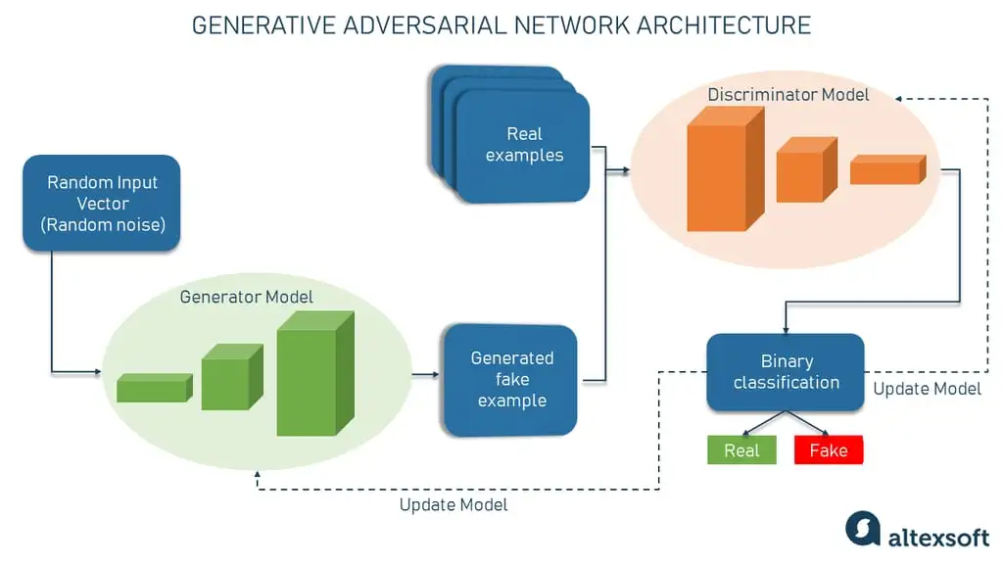
Generative Models: GANs
The Generator generates synthetic samples given a random noise [sampled from a latent space]
Discriminator is a binary classifier that discriminates between whether the input sample is real [output a scalar value 1] or fake [output a scalar value 0]

Slide 9
Discriminative vs Generative Modeling
Discriminative modeling is used to classify existing data points (e.g., images of cats and dogs into respective categories). It mostly belongs to supervised machine learning tasks.
Generative modeling tries to understand the dataset structure and generate similar examples (e.g., creating a realistic image of a dogor a cat). It mostly belongs to unsupervised and semi-supervised machine learning tasks.
Instead of predicting a label given to some features, GenAI tries to predict features given a certain label

Slide 10
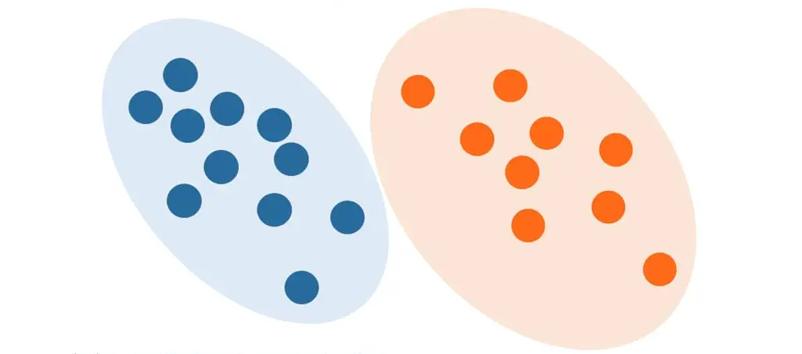
Generative Modeling
Mathematically, generative modeling allows us to capture the probability of x and y occurring together. It learns the distribution of individual classes and features, not the boundary.

Slide 11
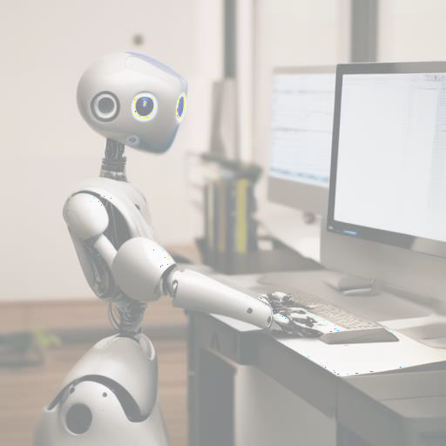
GenAI Use Cases
Guiding principle:
difficult to create, but easy to check
Code
Task sequences
Short text (copywriting) Document search Summarisation Templated text
Contribute to complex text
Images, Video – creation and editing
Easier to check

Slide 12
Ethical Dilemmas
Data Privacy & Consent: Generative AI often uses extensive datasets, raising questions about the privacy and consent of individuals whose data is included.
Authenticity & Misinformation: The ability to create realistic content can blur the line between real and artificial, potentially fueling misinformation and the spread of deepfakes.
Bias & Fairness: AI systems can inherit and amplify biases from their training data, leading to skewed and unfair outcomes in various applications.
Intellectual Property Concerns: The ease of creating content with generative AI challenges traditional notions of creativity, raising issues around copyright and originality.

Slide 13
Ethical Dilemmas Cont.
Economic Impact: As generative AI automates more tasks, there's potential for significant job displacement, particularly in creative fields.
Responsibility & Accountability: Determining liability for decisions made or actions taken by AI systems can be complex, especially when outcomes are unexpected or harmful.
Regulation & Governance: The rapid development of generative AI technologies poses a challenge for regulators aiming to protect individuals and society while fostering innovation.

Slide 14
The Future of Generative AI
Enhanced Creativity and Personalization: Future generative AI will push the boundaries of creativity, offering unprecedented personalization in art, music, design, and content creation.
Expansion into New Industries: Generative AI will expand into new sectors such as healthcare, engineering, and education, offering innovative solutions and transforming traditional practices.
Seamless Human-AI Collaboration: Advancements will enable more intuitive and productive collaborations between humans and AI, enhancing creative processes and decision-making.
Advancements in AI Safety and Security: With the increasing capabilities of generative AI, there will be a parallel focus on enhancing AI safety, security measures, and protocols to prevent misuse.

Slide 15
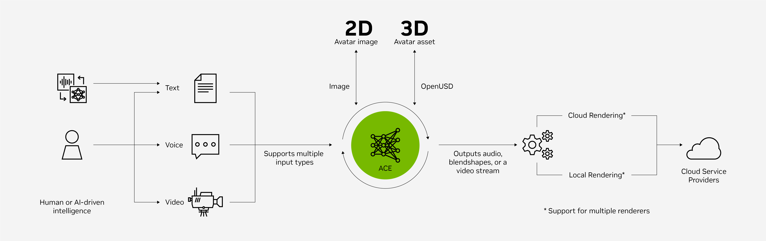
A New Reality?

Slide 16
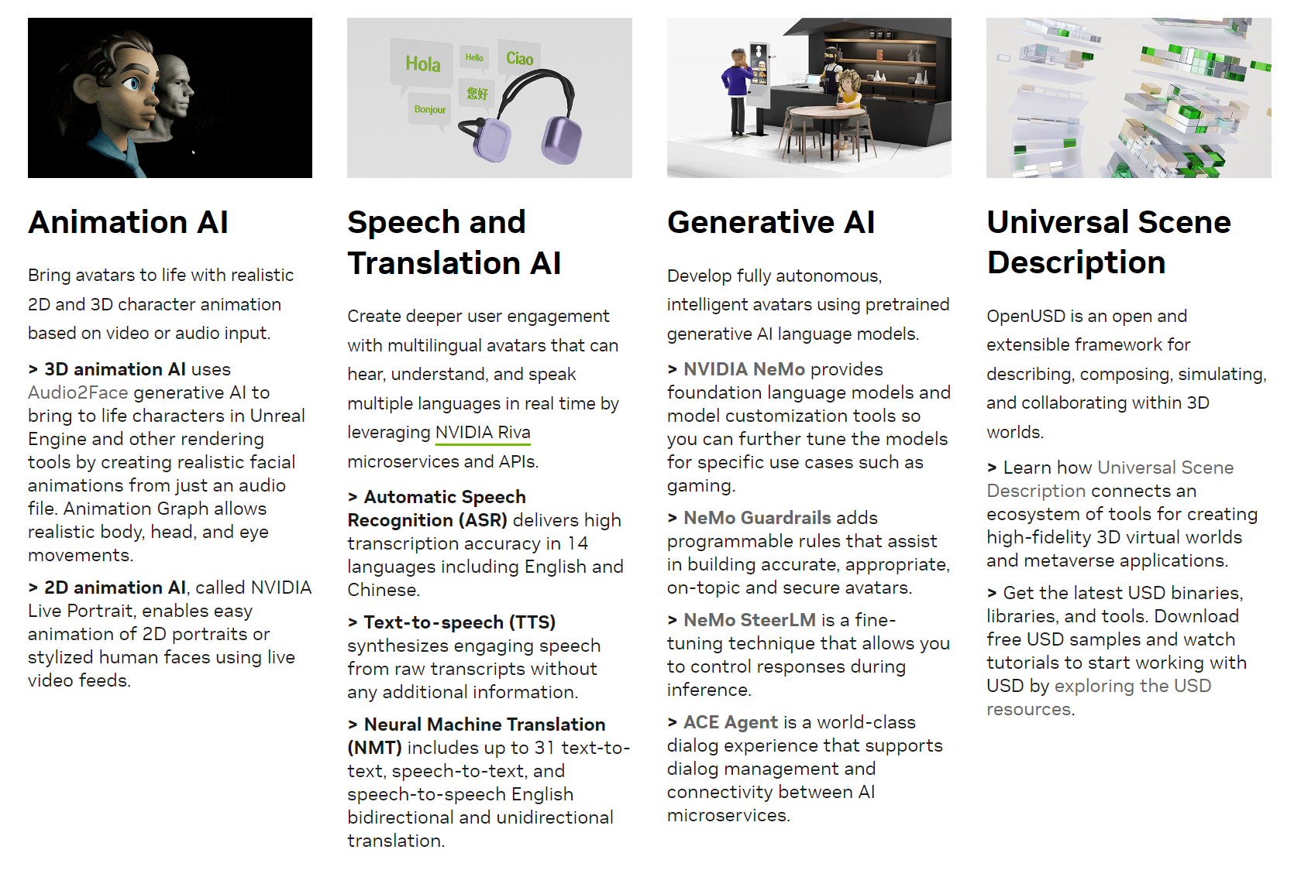
ACE Components

Slide 17
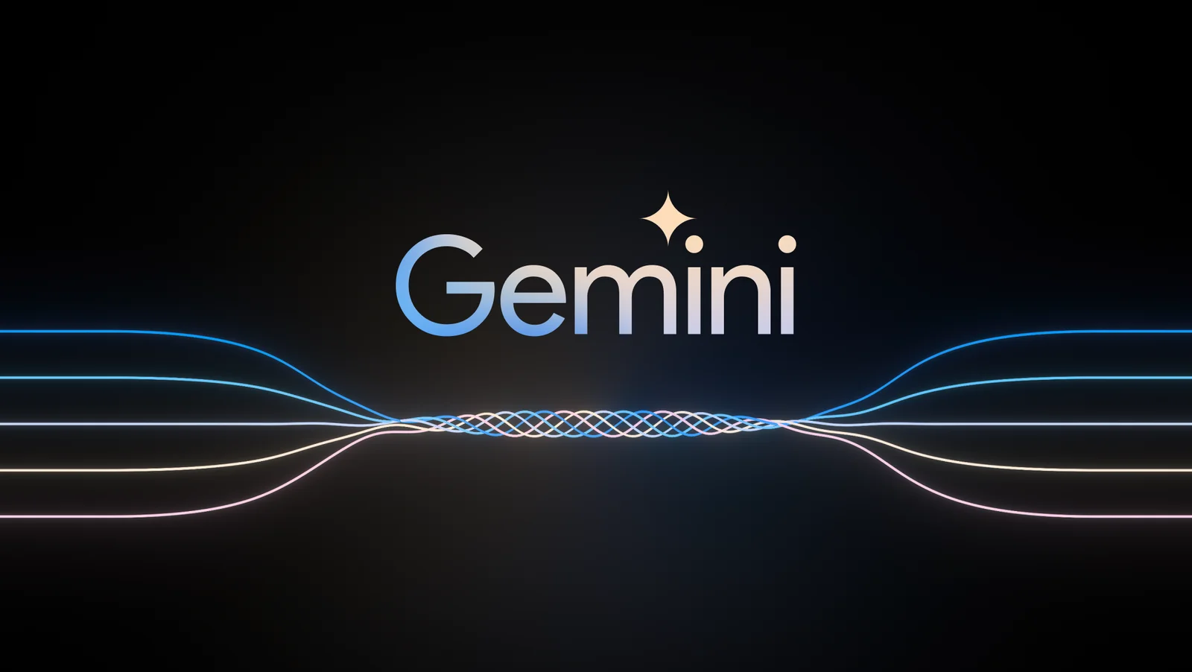
Current Advances

Slide 18
What is Gemini
With a score of 90.0%, Gemini Ultra is the first model to outperform human experts on MMLU (massive multitask language understanding), which uses a combination of 57 subjects such as math, physics, history, law, medicine and ethics for testing both world knowledge and problem-solving abilities.
Sophisticated Reasoning
Understanding text, images, audio and more
Advanced coding in Python, Java, C++ and Go
Better scalability and efficiency

Slide 19
AGI
A field of theoretical AI research that attempts to create software with human-like intelligence and the ability to self-teach
Symbolic approach assumes that computer systems can develop AGI by representing human thoughts with expanding logic networks
Connectionist (or emergentist) approach focuses on replicating the human brain structure with neural-network architecture
Challenges
Making connections that changes domains
Emotional intelligence
Sensory perception

Slide 20
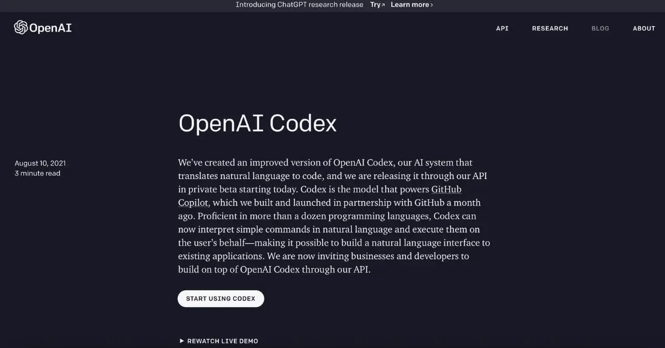
Should CS People be Concerned?

